Slide 1
MSc AI for marketing strategy
Project Management
Session #2
Robert Fonteijn

Slide 2
Basic model for a website
Awareness
Purchase
Emotional
Entertain
Inspire
Educate
Convince
Rational

Slide 3
Reminder: Project Management : a 3-Phase Approach
Phase I: Build a Business Case
Phase II: Initiate the Project
Phase III: Define & Imple-ment the Project Plan
Business opportunity & suggested solution
Project objectives, scope & approach
Project deliverables & business outcomes
Strategic alignment
Dependencies & constraints
Risk assessment & mitigation
Change impact assessment
Project costs
Benefits
Net present value
Key success factors & KPIs
Project charter
Project challenges and key success factors
RACI matrix
Stakeholder analysis
High-level project plan
Detailed project plan
Project dashboard
Parking lot
Punch list
Post project evaluation report

Slide 4
Friday = Change Management : a 4-phase approach
Phase I: Define the Change Mgt Strategy
Phase II: How people experience change
Phase III: Develop the Change Management Plans
Phase IV: Implement, Track & Manage Progress
Company’s strategy
Required change to implement the strategy
Business roadmap
Company readiness for change
Structure and size of change mgt team
Roles & responsibilities
Guiding principles
Change Lean Canvas
Change impact assessment
Objectives and levers (ADKAR Model)
Change Commitment Curve
Change Personal Transition Curve
Heart & Mind Human Drivers
Innovation Adoption Curve
Maslow Hierarchy of Human Needs
Four Stages of Team Development
Stakeholder analysis
Overarching change management plan
Communication plan
Sponsorship plan
Coaching plan
Training plan
Resistance management plan
Governance
Overarching change management plan status report
Communication plan status report
Sponsorship plan status report
Coaching plan status report
Training plan status report
Resistance management plan status report
Change reinforcement

Slide 5
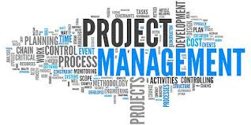
Agenda for this S2
Finishing up with the exercises
Risk management
Waterfall vs Agile
Gantt charts
WBS

Slide 6




Exercise – in teams
What are your main project challenges ?
Please use the vocabulary of the Principles and Performance Domains ».

Slide 7
12 Principles and 8 performance domains
A principle is a norm, rule, value or fundamental truth which serves as a guide for behaviour or action.
Principles are not prescriptive. They don’t tell you how to do something. They simply underpin the things that you should be doing.
Principles are designed to inform your actions. They don’t prescribe your actions.
A Project Performance Domain is a group of related activities that are critical for the effective delivery of project outcomes.

Slide 8
The 12 Principles
Success | Communication
Project Manager | Progress
Commitment | Lifecycle
Structure | Culture
Definition | Risk
Transparency | Accountability

Slide 9
Stakeholder
Team
Uncertainty
8 Project
Performance
Domains
Approach &
Life cycle
Management
Delivery
Planning
Project work

Slide 10

Exercise – in teams
Read : https://project-management.com/understanding-responsibility-assignment-matrix-raci-matrix/
… and draw up a RACI chart for your project.
25’

Slide 11
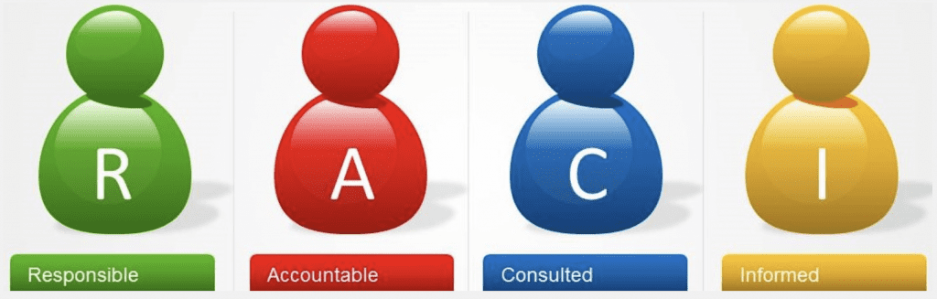
RACI

Slide 12
Exercise – in teams
Please draw up a stakeholder analysis for your project.
20’

Slide 13
Stakeholder analysis
A stakeholder analysis is a process of identifying these people before the project begins; grouping them according to their levels of participation, interest, and influence in the project; and determining how best to involve and communicate each of these stakeholder groups throughout.

Slide 14
Five steps
Identify the stakeholders.
Clarify the interest of each stakeholder.
Clarify the influence of each stakeholder.
Determine the process of engagement between stakeholders.
Manage the relationship with stakeholders from a PM point of view.

Slide 15
A table
Stakeholders | Interest | Influence | Intra-process | Management
1.
2.
3.
Etc

Slide 16
Agenda for this S2
Finishing up with the exercises
Risk management
Waterfall vs Agile
Gantt charts
WBS

Slide 17
Risk sources
Risk source | Description
Risk repository | Historical data of risks of completed projects. Can be used to identify potential risks.
Checklist analysis | A questionnaire that helps identify potential risks.
Expert judgment | Interviews with experienced project managers, subject matter experts and stakeholders.
Project status | The files of status reports, quality reports, meeting reports etc.

Slide 18
Risk categories
Risk category | Comments
Technical | Requirements, technology, interfaces, performance, quality…
External | Customer, contract, market, supplier…
Organisational | Dependencies, logistics, resources, budgets…
Project-related | Planning, schedule, estimates, communication…

Slide 19
Risk exposure
Probability | Description
High | 80 – 100%
Medium-High | 60 – 80%
Medium-Low | 30 – 60%
Low | 0 – 30%
Rating | Description
High | Catastrophic, rating A
Medium | Critical, Rating B
Low | Low – Marginal, Rating C

Slide 20
Risk impact – on 3 levels
Objectives | C Medium low, Low | B Medium | A Medium high, High
Cost
Schedule
Scope
Quality

Slide 21
Risk occurrence: timeframe
Timeframe | Description
Near | Now to 1 month
Mid | Next 2 to 6 months
Far | Over 6 months

Slide 22
Exercise - teams
What risks can you identify for your projects Why are they a risk?
What kind of impacts does each of your identified risks have? Can you categorise these as low impact, medium impact, or high impact?
How probable are each of your identified risks? Categorise them as not very likely, likely, and highly likely to occur.
What would you analyse as the three most critical risks?
What would you suggest to do about these three risks? Are there specific actions to deal with these risks? Can you identify a contingency plan to carry out if the risk occurs?
20’

Slide 23
Agenda for this S2
Finishing up with the exercises
Risk management
Waterfall vs Agile
Gantt charts
WBS

Slide 24
Please watch
“Steering projects without long-term plans”
Sommer and Wiland
TED
11’49

Slide 25
Possible learnings
The notion « everything must be precisely planned » is not terribly useful.
Deal with the « fear of failure » problem.
Remember: in the end it’s the result that matters, not the plan.
« Scrum » as an agile project management technique.
This requires two things:
Project manager « holding the frame » (not unlike a coach).
Managing the context / culture.

Slide 26
Exercise – in teams
Please articulate the differences in using waterfall vs agile for your project.
20’

Slide 27
Agenda for this S2
Finishing up with the exercises
Risk management
Waterfall vs Agile
Gantt charts
WBS

Slide 28
The GANTT Chart
A Gantt chart, commonly used in project management, is one of the most popular and useful ways of showing activities (tasks or events) displayed against time.
On the left of the chart is a list of the activities and along the top is a suitable time scale.
Each activity is represented by a bar; the position and length of the bar reflects the start date, duration and end date of the activity. This allows you to see at a glance:
What the various activities are
When each activity begins and ends
How long each activity is scheduled to last
Where activities overlap with other activities, and by how much.
The start and end date of the whole project

Slide 29
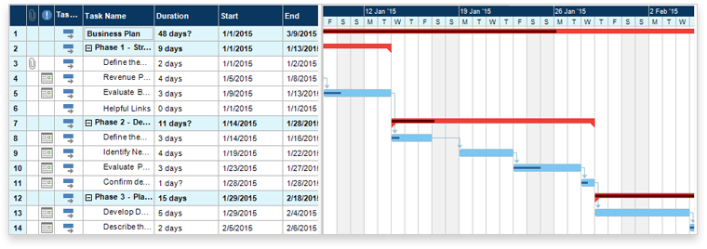
This is what it might look like

Slide 30
Exercise – in teams
Please draw up a GANTT chart for your project.
20’

Slide 31
Please watch
The Secret to Life from a PMP | Amy Hamilton | TEDxStuttgart
https://www.youtube.com/watch?v=CTn0HYmMAYM
Make notes of the main points that interested you and formulate questions you have.

Slide 32
Agenda for this S2
Finishing up with the exercises
Risk management
Waterfall vs Agile
Gantt charts
WBS

Slide 33
WBS
Purpose:
Subdivide a complicated task into smaller tasks until you reach
a level that cannot be further subdivided. WBS is done before scheduling and involves 3+ levels, such as:
Programme – Project – Task – Subdivision(s) of task or
Macro – Meso – Micro.
Exercise: in teams:
Do a WBS for « Finding sponsors ».

Slide 34
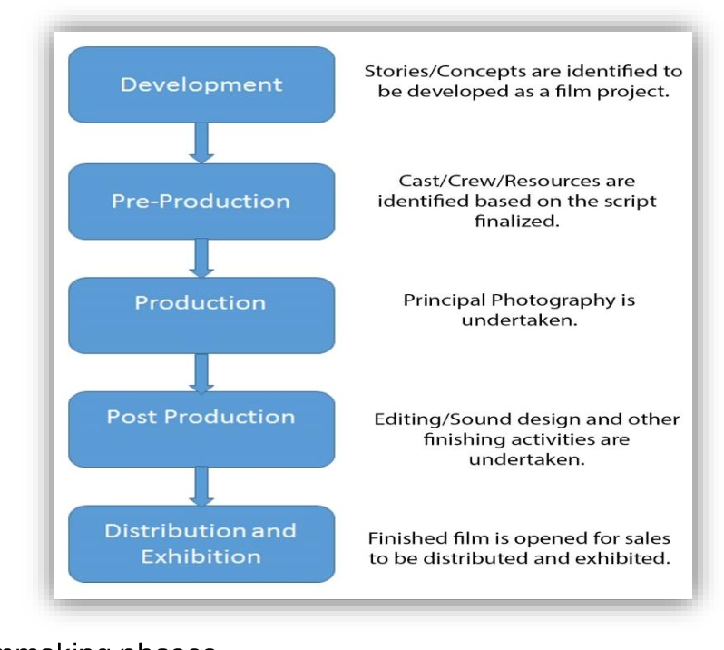
WBS for making a movie

Slide 35
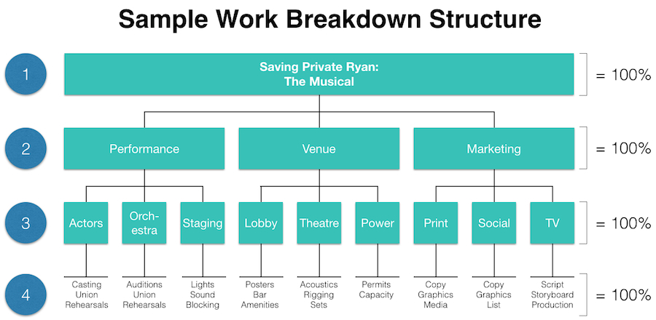
Example of a WBS

Slide 36
Work for Friday: the A-Z of project management
Subject Agile etc. | What is it? Is the definition clear? Are there alternative definitions? Do some additional research. | Why are we interested? What is the relevance of this subject for project managers ? Give concrete examples for your project, specific business sectors or companies. | How can we use this in practice? What do we think of this subject? How can we apply it in our professional or personal lives ?

Slide 37

Feedback ?
Your reaction after this session 2 :
“WWW” – What Worked Well
“EBI” – Even Better If

